Slide 1
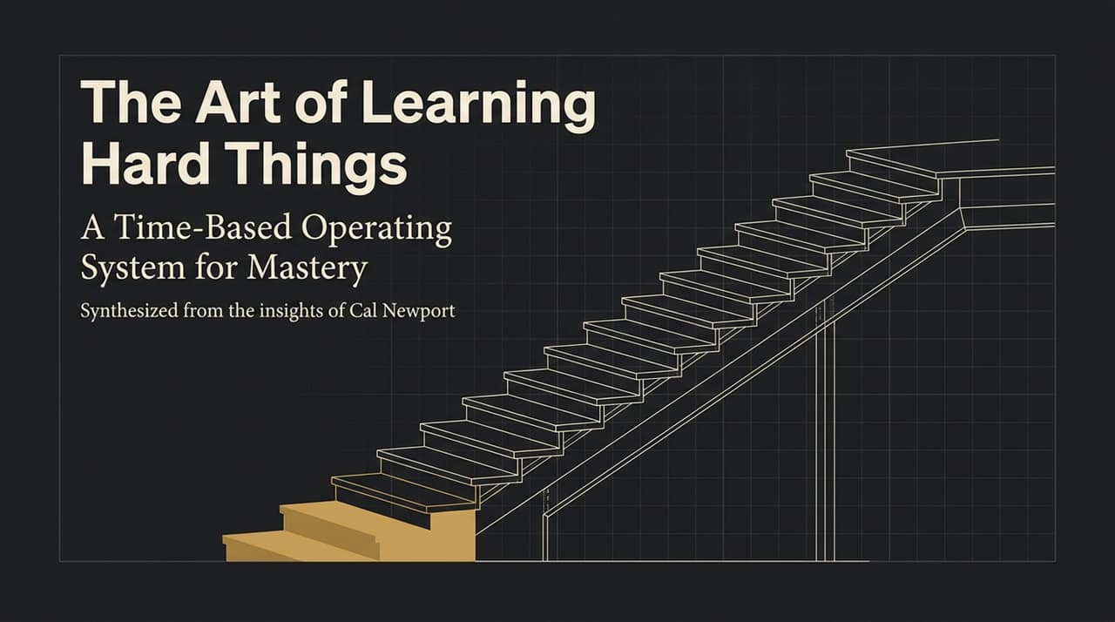
Notes:
Welcome, everyone. Today, we’re unpacking a comprehensive framework for learning hard skills—whether that means mastering complex software systems at work or developing deep personal expertise. Most people struggle to learn hard things because they rely on flawed assumptions about intelligence and effort.
In this presentation, based on Cal Newport’s operating system for deep life cultivation, we will deconstruct those misconceptions and replace them with a practical, time-managed process.
Key Points:
Core Premise: Mastery is not an inherent trait; it is the output of a designed, time-based operating system.
Objective: Shift focus from raw talent to deliberate practice and long-term time investment.
https://www.youtube.com/watch?v=RrLKXRXVrKM

Slide 2
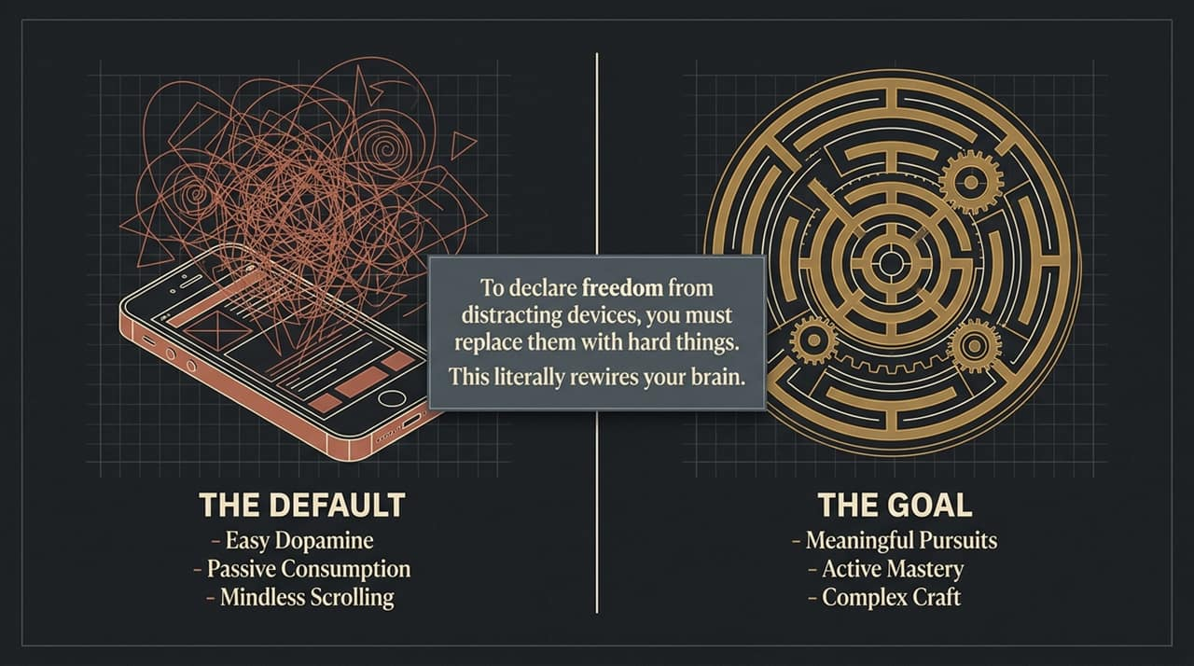
Notes:
Look at the left side of this slide: 'The Default'. In modern life, our default setting is easy dopamine—mindless scrolling, constant phone checking, and passive consumption.
To declare true freedom from distracting devices, simple elimination isn't enough. You must replace those low-value habits with ambitious, meaningful pursuits.
Engaging in complex, challenging skills literally rewires your brain so that easy dopamine becomes far less appealing.
Key Points:
The Default Trap: Easy dopamine creates cognitive fragmentation.
The Goal: Active mastery and complex craft.
Mechanism: Substitution over sheer willpower—rewire brain cravings by tackling hard tasks.

Slide 3
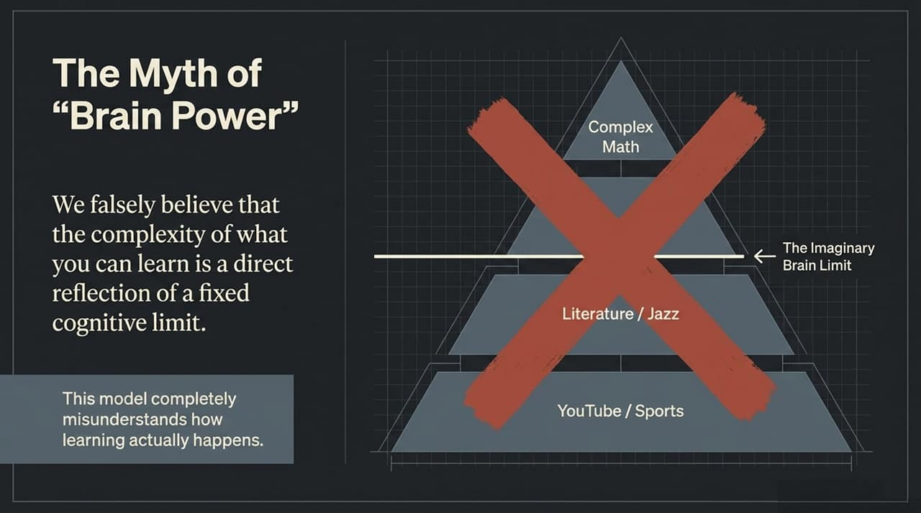
Notes:
When people look at high-level skills—like advanced mathematics, academic literature, or complex music analysis—they naturally stack them in a hierarchy.
Most people assume there's an 'Imaginary Brain Limit' where their IQ prevents them from moving up from YouTube videos to complex math proofs.
Cal Newport emphasizes that this mental model is completely wrong. We mistake the height of a skill for a fixed cognitive boundary.
Key Points:
The Myth: Cognitive capacity acts as a strict ceiling on subject difficulty.
The Flaw: Assuming someone who understands higher-level subjects simply possesses an innate 'bigger brain'.

Slide 4
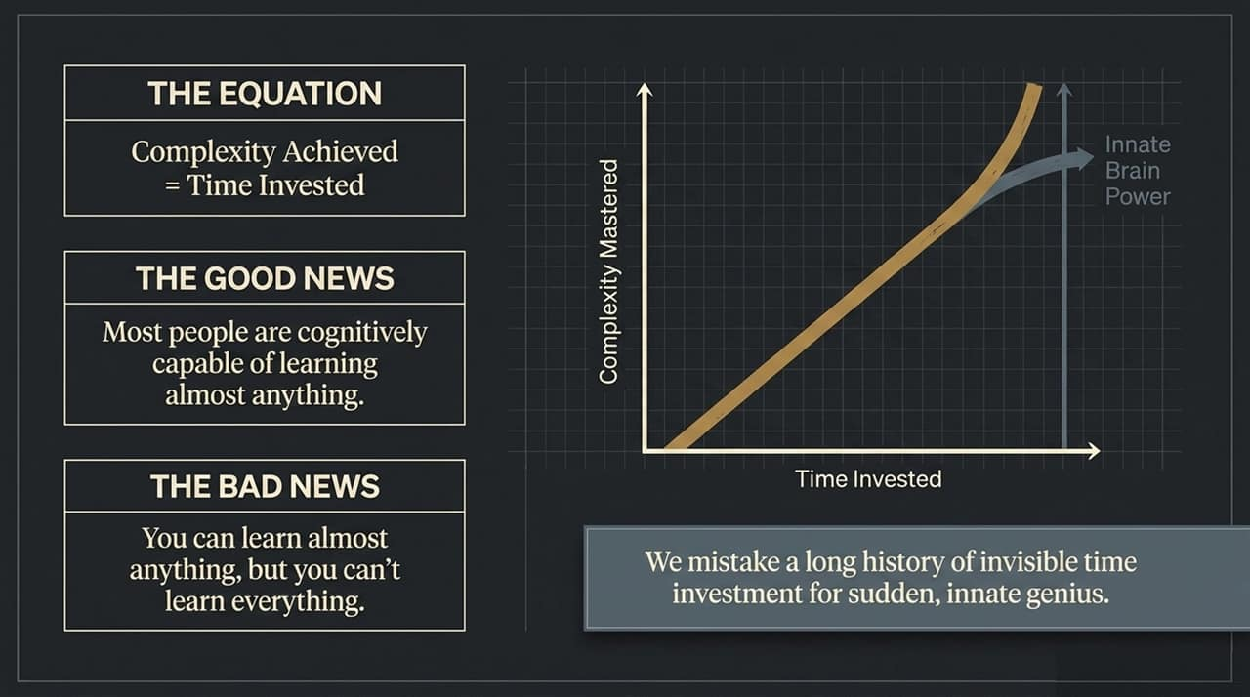
Notes:
Here is the reality of how learning works. Complexity achieved is a function of time invested.
The Good News: Most adults are cognitively capable of learning almost anything on that hierarchy—whether it's calculus, literature, or programming.
The Bad News: You can learn almost anything, but you cannot learn everything. Because master-level skill takes substantial time, and time is finite, you must choose your pursuits carefully.
Key Points:
Primary Variable: Time spent in structured learning, not innate genius.
Illusion of Genius: We mistake long periods of invisible time investment for sudden innate talent.

Slide 5
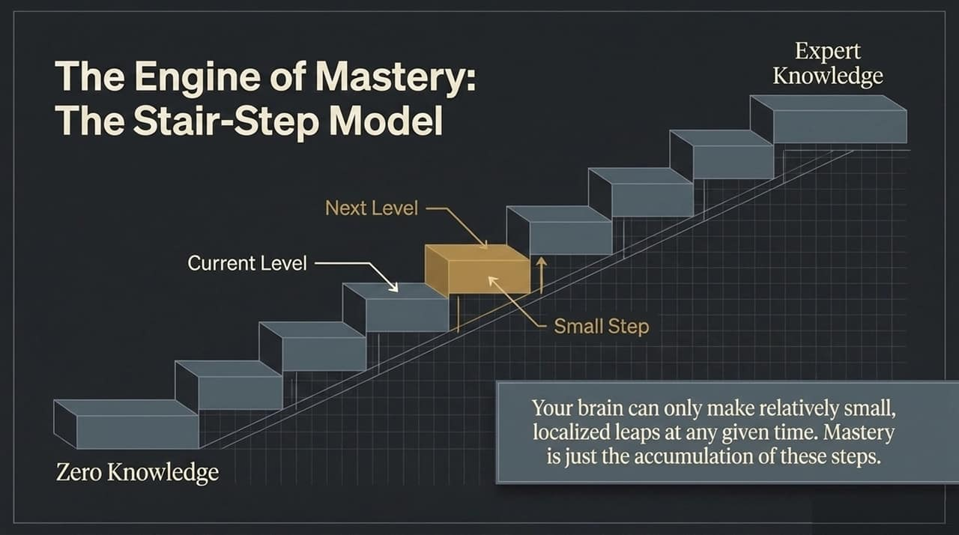
Notes:
How do people actually reach expert knowledge? Through the Stair-Step Model.
Your brain cannot make giant leaps from zero knowledge straight to expert level. At any point, your brain can only make small, localized steps from your current level to the immediate next step.
Expertise is simply the patient accumulation of dozens of these small stair steps over months and years.
Key Points:
Localized Leaps: Progress happens strictly one step at a time.
Accumulation: Long-term mastery is built on structured consistency.

Slide 6
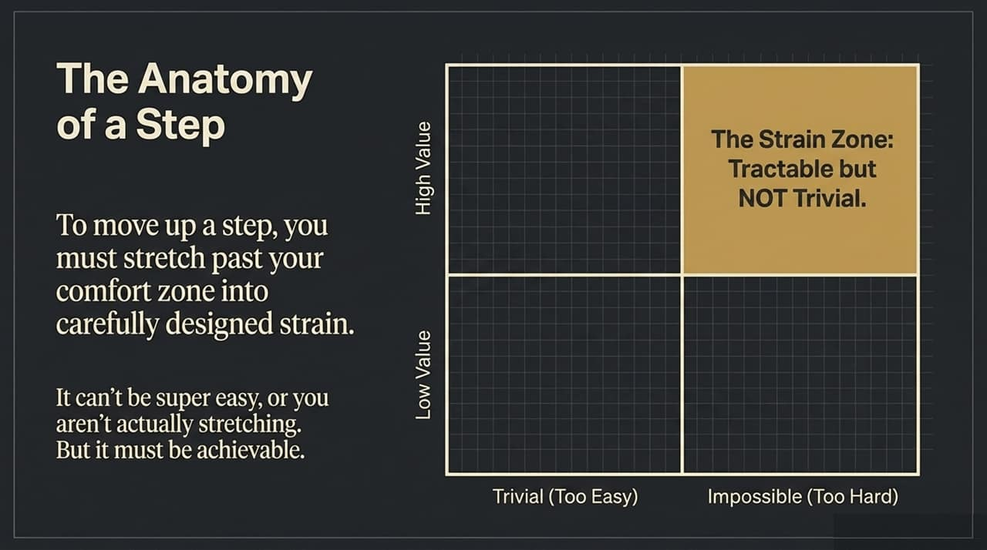
Notes:
To climb a step, you must engage in deliberate practice. This requires pushing into the Strain Zone.
If a task is too easy (trivial), you aren't stretching your brain, and no growth happens.
If a task is too hard (impossible), you will bounce off it in frustration.
Effective learning happens exclusively in the middle: tasks that are tractable but NOT trivial—challenging enough to create uncomfortable cognitive strain, but structured enough to accomplish.
Key Points:
Strain Requirement: Growth requires deliberate discomfort outside the comfort zone.
Target Range: Exercises must be tractable (achievable) yet non-trivial (stretching).

Slide 7
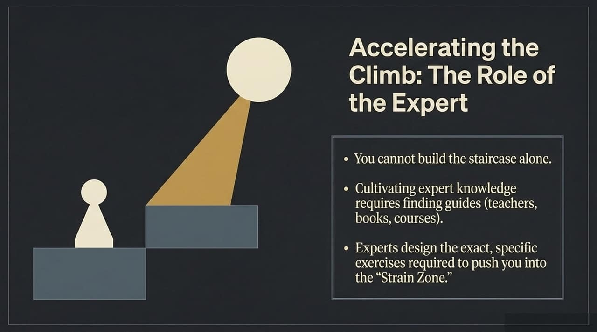
Notes:
You don't need to construct this staircase entirely from scratch.
The primary role of experts—whether teachers, curated books, or formal courses—is to design the exact exercises that land you in that optimal Strain Zone.
Experts know what step comes next so you don't waste energy attempting impossible leaps or idling in trivial exercises.
Key Points:
External Guidance: Expert materials shorten the feedback loop.
Curriculum Design: Experts prevent premature leaps and ensure proper pacing.

Slide 8
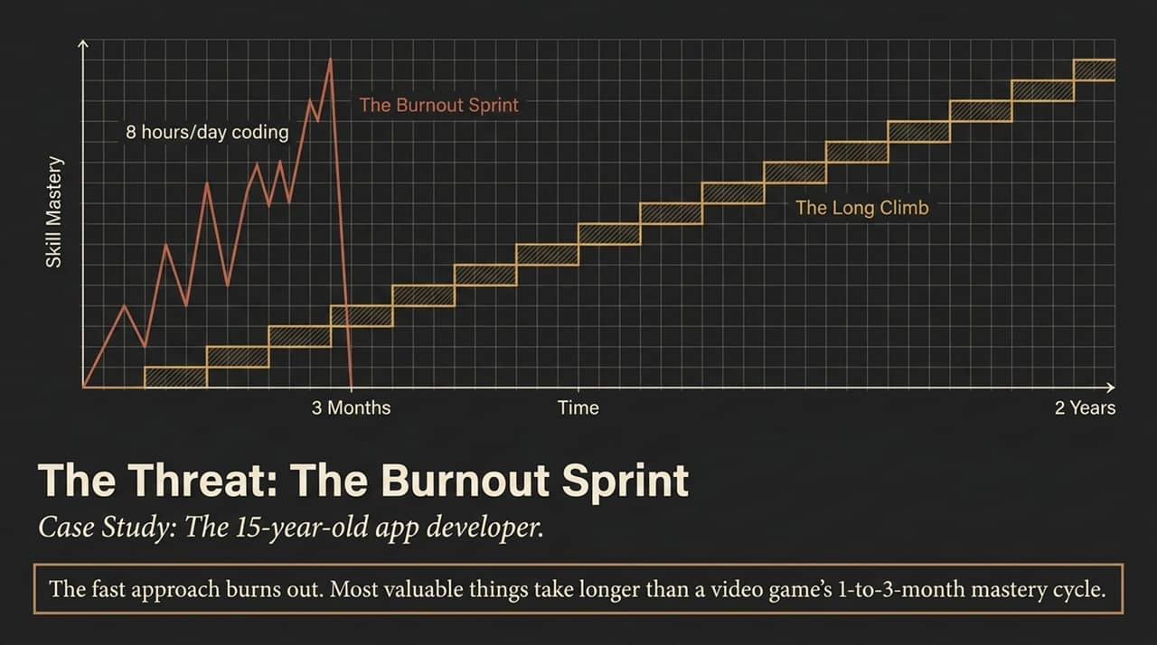
Notes:
Look at the case study on this slide: a 15-year-old student trying to code 8 hours a day to launch an app in 3 months.
Cal Newport points out that young people often absorb this model from video games, where mastery happens in a 1-to-3-month feedback cycle.
In real life, this leads to the Burnout Sprint—a rapid burst followed by complete collapse.
The solution is Slow Productivity: take longer and vary your pace. Alternating deep strain with refractory recovery over a 2-year horizon builds far more sustainable skill than temporary bursts.
Key Points:
The Trap: Video-game mental models trick us into expecting fast mastery.
Slow Productivity Principle: Shift timelines from weeks to multi-year horizons.
Seasonal Pacing: Combine intense strain periods with intentional recovery phases.

Slide 9
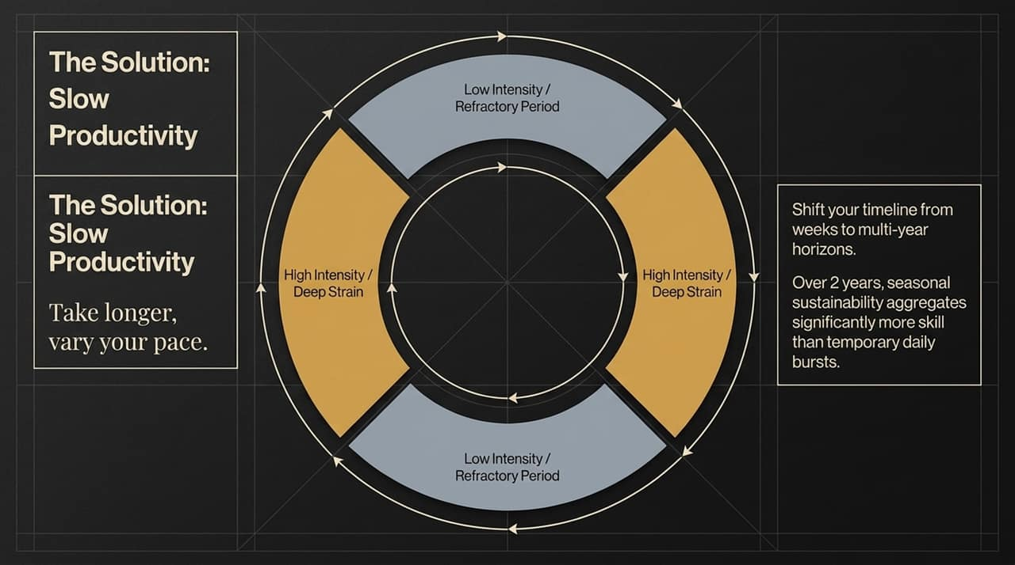
Notes:
To learn hard things while managing modern life, you must practice Cognitive Offloading.
Your brain’s working memory is extremely limited. Trying to store daily tasks, long-term visions, and active ideas inside your own head creates constant noise.
Rule number one of system design: Don't mix a 20-year vision with your weekly grocery list.
Key Points:
Cognitive Load: Keep brain capacity free for deep learning, not administrative tracking.
Separation: Isolate temporary notes, active obligations, and long-term ideas.

Slide 10
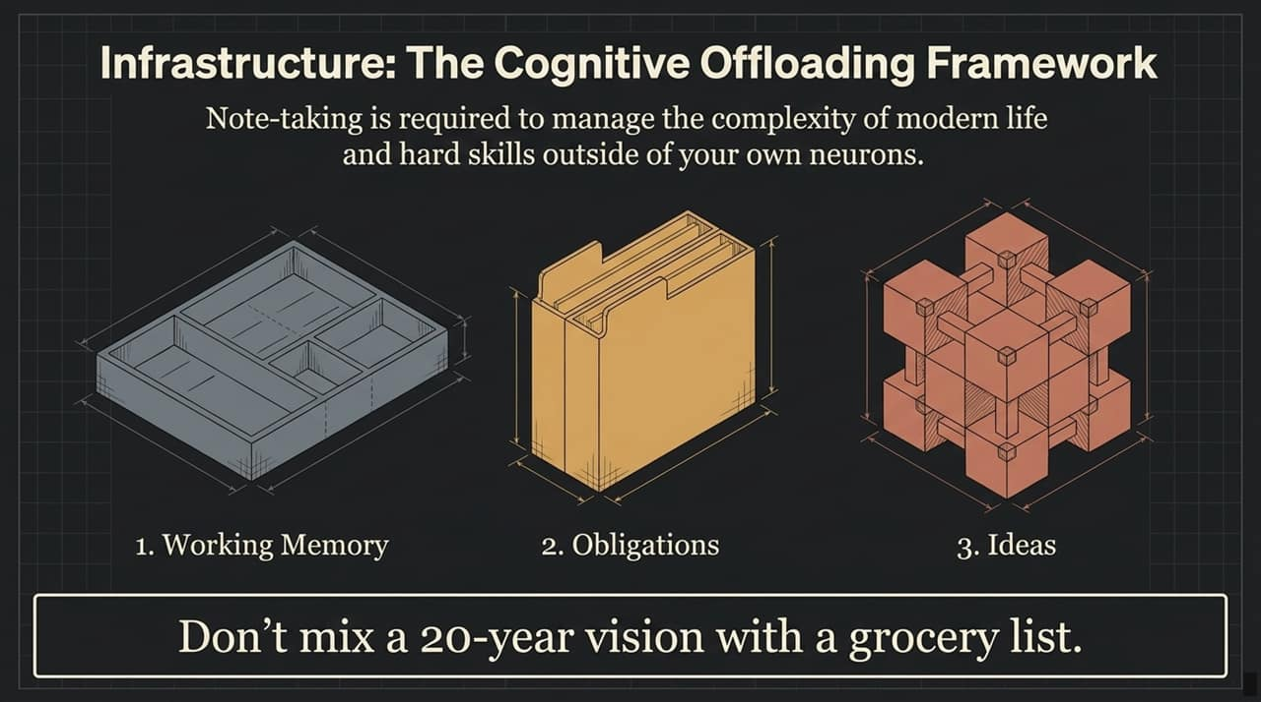
Notes:
Here is Cal Newport's concrete 3-tier matrix for managing information:
1. Working Memory Extender: A simple plain text file on your desktop. It holds temporary notes during meetings or task switching and resets every 10–15 minutes.
2. Obligation Tracker: Systems like Trello or task lists used for daily referencing—one board per role, one card per task.
3. Idea Capture: Long-term synthesis notebooks (like a Remarkable 2 or digital journal) reviewed periodically over months for reflections and big vision.
Key Points:
Tiered Refresh Rates: Match tool retention times to task frequency.
Simplicity: Focus on functional capture rather than overly complex note setups.

Slide 11
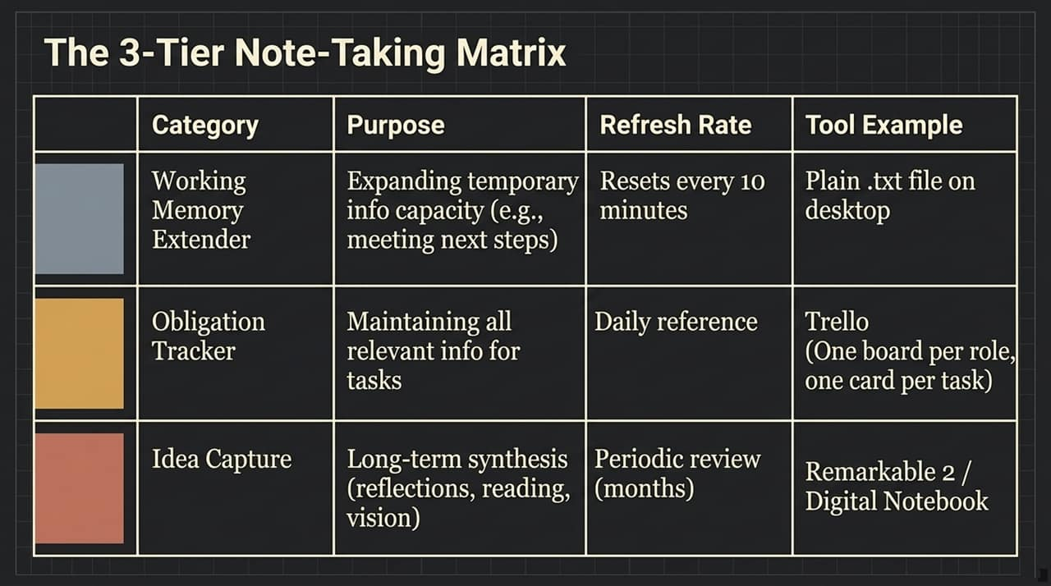
Notes:
Where do you find time for these multi-year stair-step pursuits? By implementing the Phone Foyer Method.
When you enter your home, plug your phone into a station in the foyer or kitchen.
It stays there as the default. It does not go to the couch, the dinner table, or the workspace.
By physically separating yourself from cheap dopamine, your brain becomes under-stimulated and naturally seeks out deeper, structured learning tasks.
Key Points:
Environmental Design: Physical separation reduces reliance on willpower.
Boredom as Leverage: Reclaim free brain zones to spark engagement in hard skills.

Slide 12
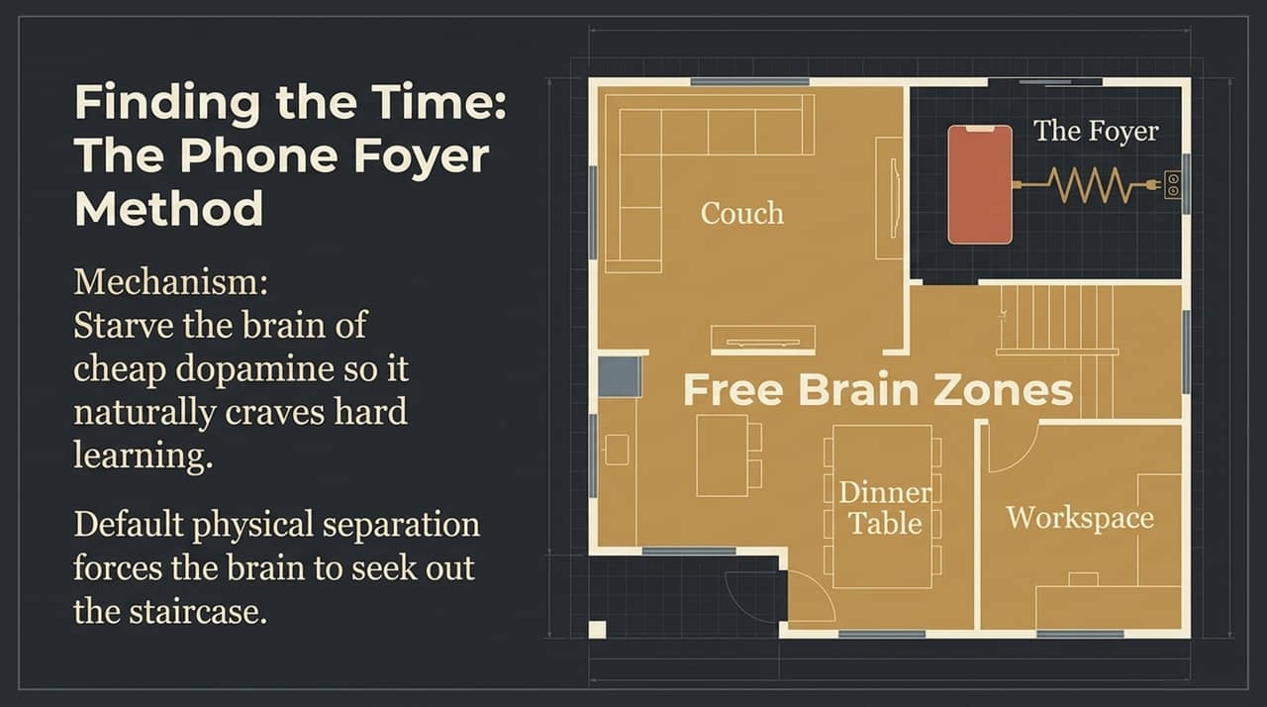
Notes:
Since time is finite, how do you select which mountains to climb?
Professionally: Look at high performers ahead of you. Target rare, complex skills that yield direct leverage—such as specialized data architecture, 3D modeling, or advanced statistical methods
Personally: Pick one deep area of connoisseurship—like sommelier training, film criticism, or serious music theory—rather than passive entertainment.
Key Points:
Evidence-Based Selection: Study industry leaders to identify impactful skills.
Depth Over Breadth: Build true connoisseurship instead of superficial interest.

Slide 13
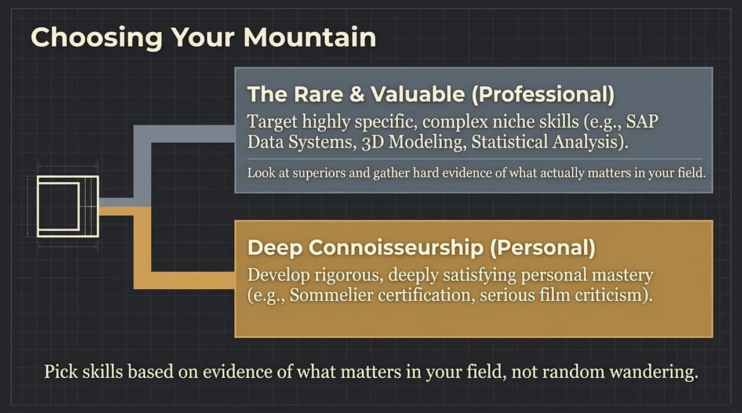
Notes:
This diagram displays the full Mastery Operating System working together:
Input: Reclaimed time via environmental rules like the Phone Foyer Method.
Engine: Slow Productivity pacing to prevent burnout over long multi-year horizons.
Mechanism: Deliberate practice steps focused on the Strain Zone.
Infrastructure: Cognitive offloading to keep your mind focused on execution.
Output: Deeply satisfying skill mastery.
Key Points:
Holistic System: Each component feeds and supports the next.
Output Focus: Sustainable execution yields long-term mastery

Slide 14
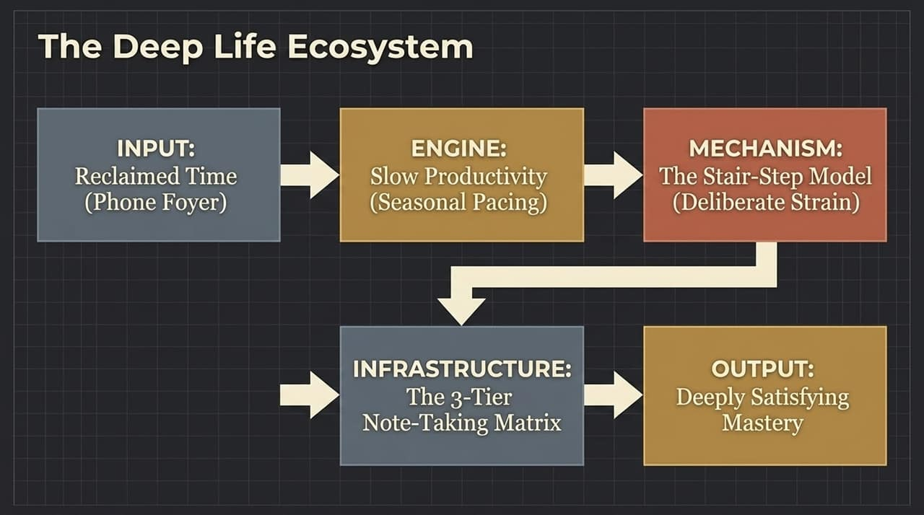
Notes:
Why go through all this effort? Aristotle addressed this in the Nicomachean Ethics.
Human beings are uniquely equipped to direct their minds toward abstract, challenging goals.
Engaging with complex, difficult skills fulfills a core aspect of human potential. Pushing your cognitive limits is fundamental to living a deeply satisfying life.
Key Points:
Philosophical Grounding: Deep intellectual effort is essential to human flourishing.
Intrinsic Reward: Mastery provides deep, lasting satisfaction that passive distraction cannot match’

Slide 15
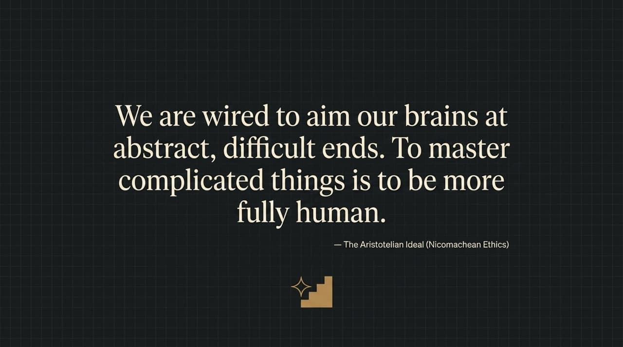
Notes:
To summarize our core model: stop viewing mastery as a test of innate IQ.
Almost anyone can master high-complexity subjects. The real bottleneck is allocating finite time to a structured staircase of deliberate practice.
Focus on making progress one step at a time through tractable, challenging exercises.
Key Points:
Core Shift: Replace 'I'm not smart enough' with 'I need to invest structured time'.
Execution Strategy: Focus entirely on the immediate next step.

Slide 16
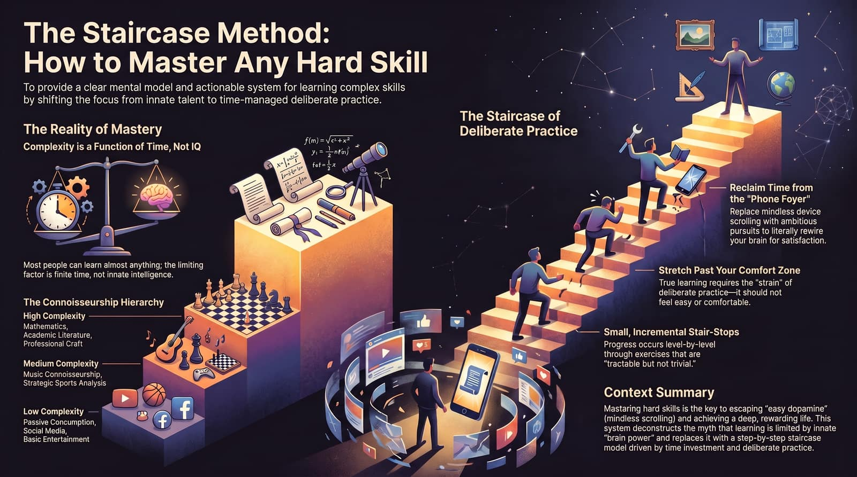
Notes:
Here are your three immediate action steps:
1. Reclaim Time: Put your phone in the foyer to remove easy digital distractions.
2. Embrace the Strain: Choose a specific project and step into tasks that feel challenging rather than comfortable.
3. Commit to the Long Climb: Shift your expectations from 30-day quick fixes to multi-year skill accumulation.
Key Points:
Step 1: Establish clear friction around device use.
Step 2: Engage in deliberate practice within the Strain Zone.
Step 3: Adopt a multi-year timeline for long-term mastery.

